Slide 1
Scotland 5G Centre - Overview
Notes:
Welcome to Scotlands 5G Future.
Me Introduction – role of Business Engagement Manager.
Role of S5GC -Scots Gov invested £124m setting up 8 Innovation Centres to grow the economy. S5GC are relatively new borne in 2019 with the remit is to transform those key sectors by innovation disruption through advanced wireless technology.
Scotland’s 5G Strategy:
“Place Scotland at the forefront of the 5G revolution and to establish the whole country as a leading 5G digital nation"
Economic Gains: £17bn increase GDP by 2035
Jobs: create 3,000 new businesses and 160,000 new jobs
​We are positioning to be one of the ‘Go to’ innovation centres – our aim to drive Scottish society forward and unlock new opportunities​ and markets through advanced wireless technologies
Today I want to touch upon learnings highlighting 5G R&D, applications, technology transition, infrastructure, and opportunities in support of the SFT Deloitte Report. This conference today will benefit SME’s by helping to understand both the challenges and the opportunities offered by the 5G rollout and emerging advanced wireless technologies in the areas of sustainable mobility and decarbonisation. ​
​

Slide 2
The Scotland 5G Centre – Who we are
The Scotland 5G Centre accelerates the deployment and use of 5G technology in Scotland’s businesses and Public Sector services.
Our remit is to enable the substantial economic and societal benefits provided by the application of 5G advanced wireless communication in Scotland.
Notes:
​

Slide 3
Our History
Established in 2019, we undertook three major projects with our funding partners:
The 5G Rural Project (University of Strathclyde) – Demonstrating new rural coverage options.
The 5G Urban Project (University of Glasgow) – A 5G research test bed for innovative applications.
The Infralink (Scottish Future’s Trust) – Tools to reduce barriers to infrastructure rollout.

Slide 4
What do we do
We manage a National Suite of fixed and mobile 5G testbeds/innovation hubs
We showcase the power of 5G to improve business
We provide access for Scotland’s organisations to test how 5G can improve their business,
We work with Scottish academic partners to support new innovation, impact and funding opportunities,
We are part of Scotland’s world leading innovation network of support for industry, public sector and academia

Slide 5
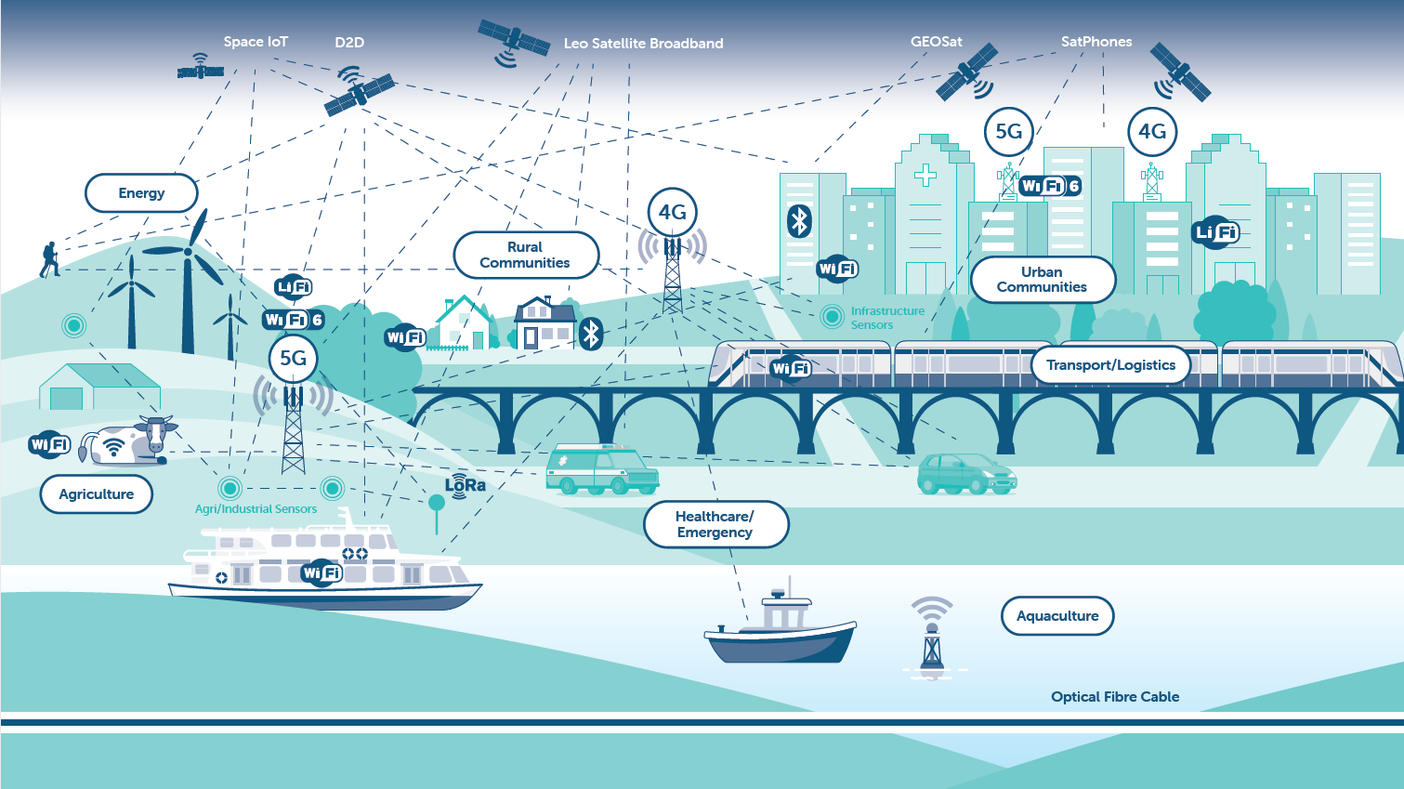
Connectivity is key
Advanced wireless connectivity increases business performance – there is a lot of complimentary technology.
Centre supports organisations in understanding and finding the appropriate solution.

Slide 6
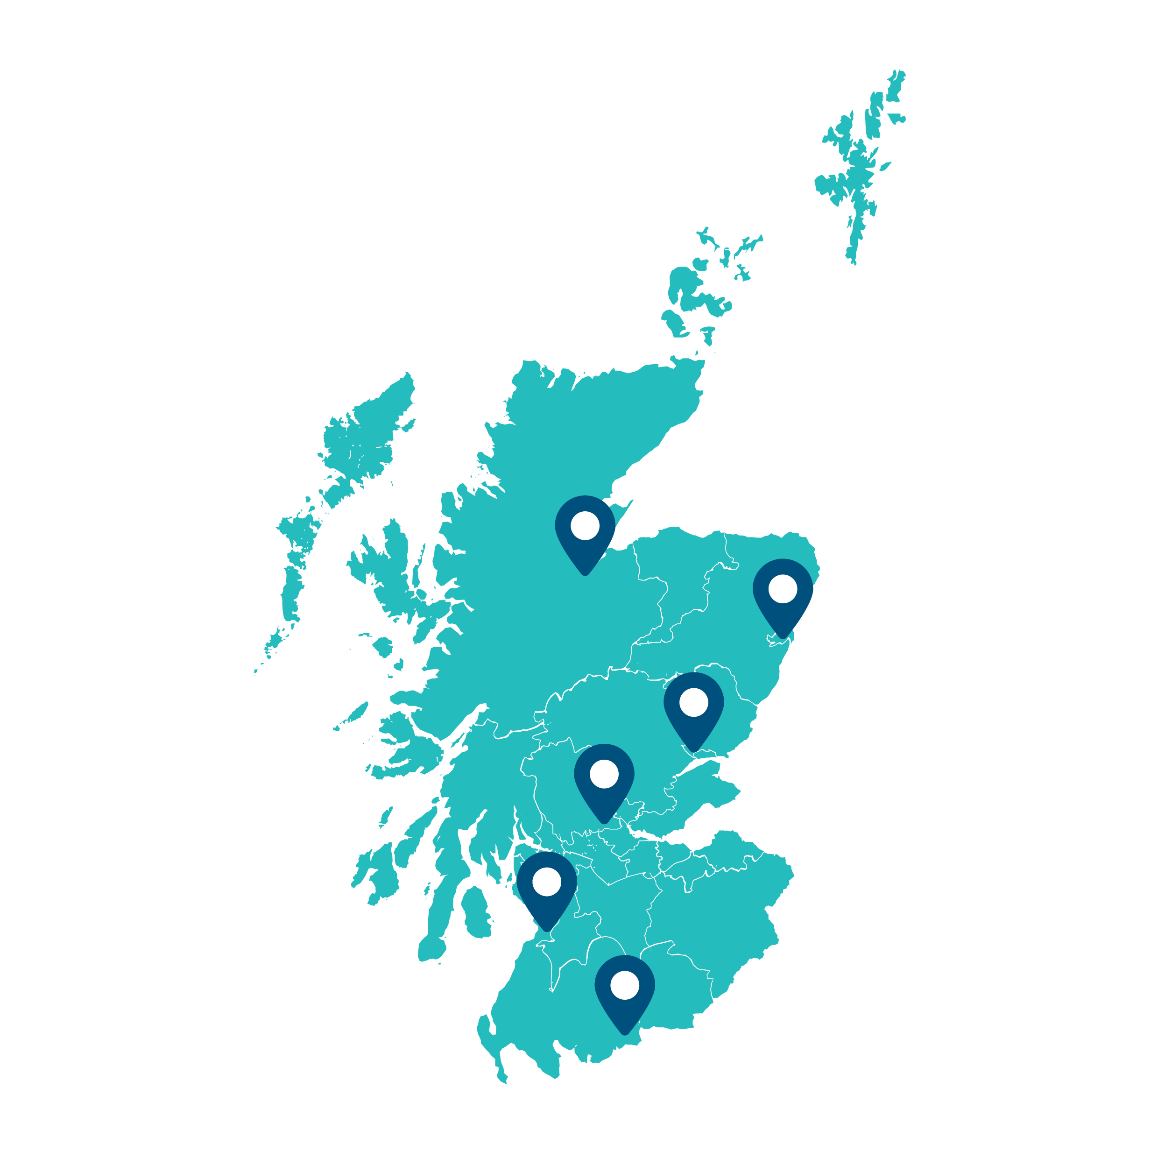
Where we operate
Our innovation hubs have state-of-the-art private 5G testbeds, providing a secure environment for business to meet with our experts and test new systems, operations, services and/or products.
Our hubs are located throughout Scotland:
Aberdeen
Dumfries
Dundee
Forth Valley
Highlands and Islands (mobile hub)
Kilmarnock
Renfrewshire (grey, to be announced)
We also have a number of Pop Up networks that
are being deployed in client sites across Scotland

Slide 7
The Scotland 5G Centre - Services
Support
Innovate
Collaborate
Take advantage of our impartial and expert advice - tailored to your business needs
Work with us to develop 5G solutions to grow
your business
Work with us to put your ideas into practice
Access workshops and live demonstrations
Find out more about how 5G
can transform your business
Work with our experts to look at solutions that will meet your needs, challenges and opportunities
Test these solutions using our state-of-the-art private 5G testbed
Get access to the latest industry applications including sensing technology and robotics
We can connect your business to our extensive network of industry partners to deploy your 5G solution
Get advice from us on the range of funding opportunities available
to support your digital transformation

Slide 8
What are the challenges industries are facing?
Energy Costs
Demand for more Sustainable Technology
Ageing Technology
Data Security
Managing Data Streams/Storage
Supply Chain Disruptions
Digital Not Spots on site
Economically competitive market
Retaining talent and developing skills in remote and rural areas.

Slide 9
Why is it important for industries to evolve and embrace 5G?
Healthcare: In 2020/21, 35% of total Scottish budget was spent on healthcare
Transport: Around 127 million passenger journeys were made by bus in Scotland in 20-21
Manufacturing: UK is the 9th largest manufacturing nation in the world
Energy: Around 100,000 people are employed within the energy sector, accounting for 46% of jobs
Agriculture: accounts for 70% of South of Scotland’s economy
It’s estimated that by enhancing 5G capability, Scotland has the potential to create 160,000 new jobs by 2035

Slide 10
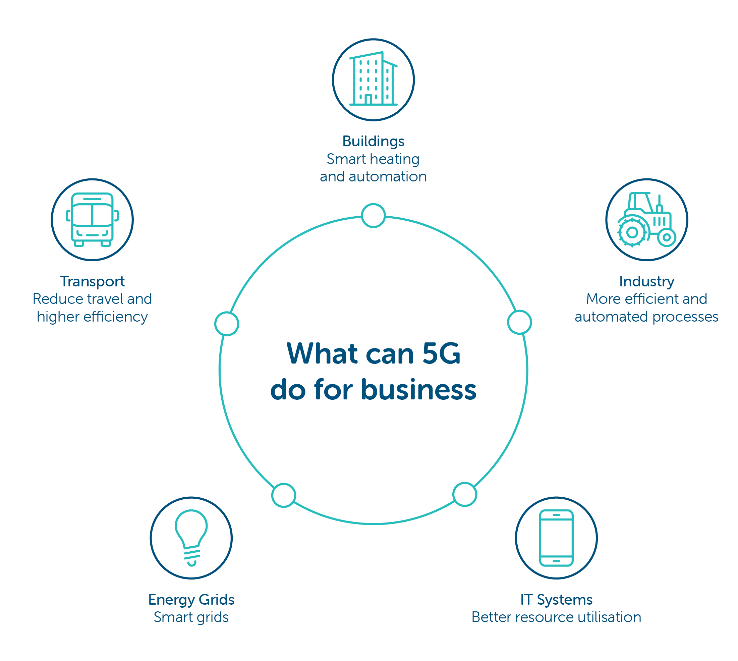
What can 5G do for business?
5G isn’t just the next generation of mobile networks – it’s transforming how we work, and connect with each other. So, in order to stay ahead of the curve, it’s key that businesses understand the capabilities of 5G and the opportunities it enables.
Notes:
Buildings Wireless connectivity can enable sensor-based smart heating and cooling processes to reduce consumption, while smart appliances could automatically coordinate to optimise energy use.
Industry Automated processes in sectors ranging from manufacturing to agriculture can increase efficiency, reducing energy and resource usage.
IT Systems Although more connected devices and sensors could increase energy use, 5G is expected to support higher energy efficiency, and related technologies such as cloud can reduce emissions compared to legacy IT systems.
Energy grid A smarter energy grid with wirelessly connected devices facilitates the integration of renewables and could allow real-time optimisation of demand and supply.
Transport Wireless connectivity reduces the need for travel and it can support smart traffic management, connected and autonomous vehicles and ride-sharing, potentially reducing congestion.

Slide 11
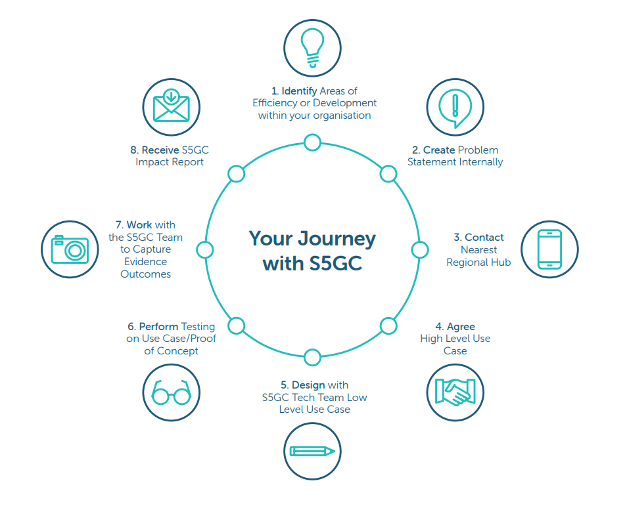
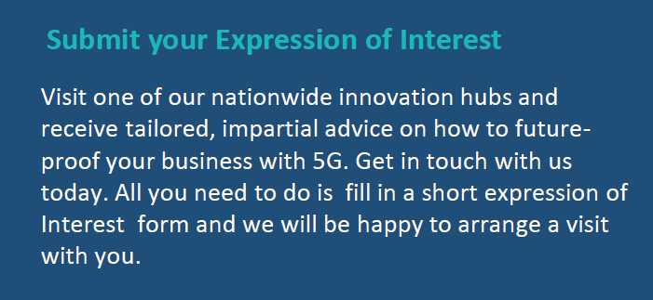
Start your 5G Journey Today

Slide 12
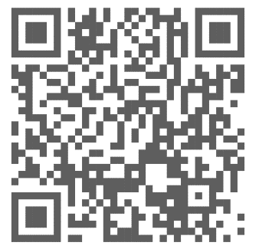
Events
Look out for S5GC events happening near you by visiting scotland5gcentre.org/events
Contact Us
on our online contact form. https://scotland5gcentre.org/expression-of-interests/
Thank you
Our Partners:
Create
new tools and services to combat cyber-crime activities.
Monthly Newsletter
The Crichton Trust
South of Scotland Enterprise
Borderlands Inclusive Growth Deal
Get the latest events and developments at the Scotland 5G Centre by signing up to our online newsletter.
www. scotland5gcentre.org

