Slide 1
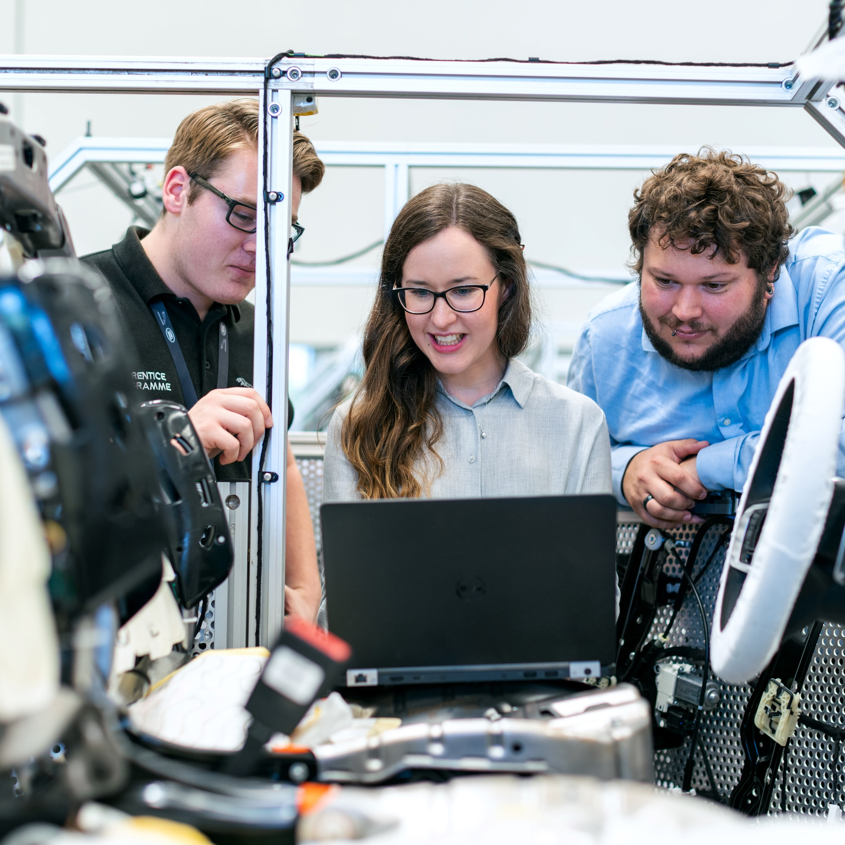






Welcome
S5GConnect Dundee Open Day
1PM Registration/Buffet food available.
1.30PM Talks
Kirsty Scott (Business Engagement Manager, S5GC)
Cllr Mark Flynn (Convener for City Development Department, DCC)
Pro Gregor White (Dean of School of Design & Informatics, Abertay Uni)
Brad McGuire (Director of Programme Innovation, AWTG)
2.15PM Demonstrations (University of Glasgow)
2.45PM Q&A & Networking
4.00PM Finish
Our Partners:
The Crichton Trust
South of Scotland Enterprise
Borderlands Inclusive Growth Deal
Notes:
Change to Dundee and Kirsty branding

Slide 2

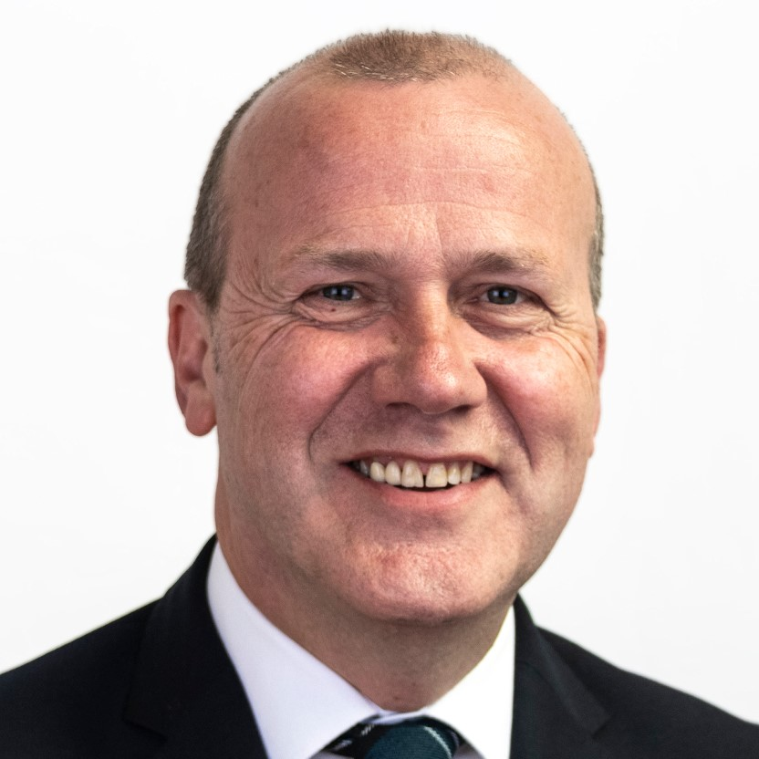

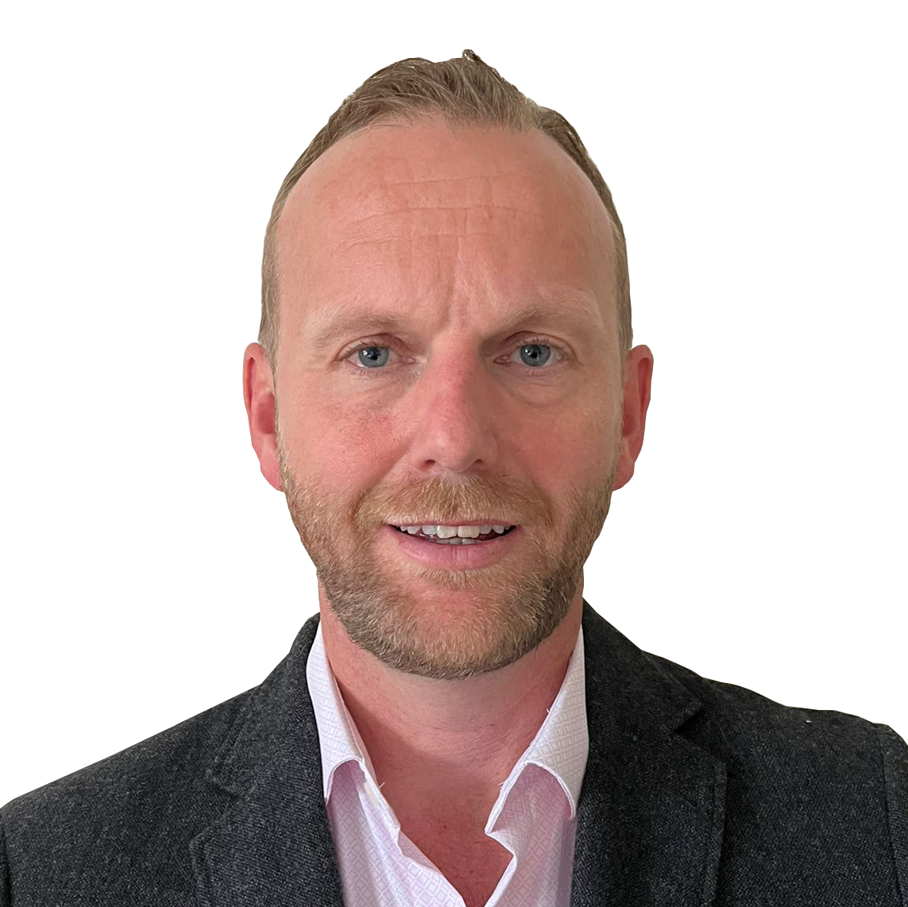

Speakers
Kirsty Scott
S5GConnect Dundee
Business Engagement
Manager
Cllr Mark Flynn
Dundee City Council
Convener for City
Development Department
Pro Gregor White
Abertay University
Dean of School of Design & Informatics
Brad McGuire
AWTG
Director of
Programme Innovation

Slide 3


5G Demos
Energy Saving 5G Solutions for Businesses
University of Glasgow
5G Extended Reality
The Future of Industrial Training
University of Glasgow

Slide 4
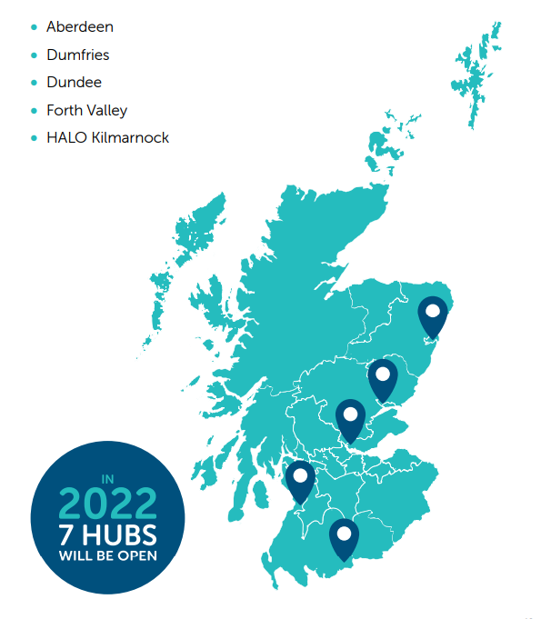

The Scotland 5G Centre - National Presence, Regional Focus
We support Scotland’s industry and the public Sector harness the power of digital transformation:
Our S5GConnect Innovation hubs and test beds are spread across Scotland.
We offer free access to cutting edge 5G test beds, to enable: new products, services, efficiency savings and innovative solutions.
We provide impartial advice to organisations wishing to set up private 5G networks.
We work with our partners to enable connectivity solutions for remote/rural businesses.
Our Business Engagement Managers are available to discuss how we can support your business.
Notes:
Start with: In order to accelerate the adoption of 5G in Scotland, we have created the S5GConnect Programme. The S5GConnect Dundee hub is 1 of the 5 hubs which are currently open and located within Scotland. The other 4 hubs are located in Dumfries, Aberdeen, Forth Valley and Kilmarnock and two more will be announced very soon.
The hubs offer the opportunity for organisations to have free access to … (content on the slide, 2nd bullet)
And we are working with organisations and companies to explore and develop (comment on the slide, 3rd bullet)
We are empowering rural communities through the 5GNew Thinking Toolkit built upon the learnings gained from 5G RuralFirst, demonstrating the technical feasibility of using netural hosting and shared spectrum to deliver connectivity in rural areas like Orkney. One of our core projects led by Scottish Futures Trust is the Infralink Project, to simplify the complexity behind the roll out of 4G and 5G infrastructure.
The other is a rural project lead by StrathSDR team headed by Prof Bob Stewart developing cost effective connectivity solutions for remote and rural areas outside broadcasting such as the Queens departure from Scotland, a unique world first.
The urban project led by UoG and the CSI team today have 2 demos provided today to help communities and businesses to overcome some of the recent challenges Scotland is facing from a connectivity perspective. Feel free to ask them questions!
The regional focus is across the Tayside regions encompassing Perth & Kinross, Angus, Fife and Dundee. This is an overview on the services we offer here and an opportunity for any organisation to come and test their products within a 5G environment – risk free! (4th bullet)

Slide 5
Digital transformation is good for business
The Scotland 5G Centre supports the public sector and business of all sizes to unlock the benefits of digital transformation.
5G is part of a suite of game changing technologies that is revolutionising how we do business, enabling for example:
1
2
3
4
5
Increased Productivity
Decreased Downtime
Improved Customer Experience
Increased
Digital
Security
Reduced
Costs
Faster turnarounds
Smart factories
Remote Operations
Upskilling
Lowering Carbon Use
Realtime Monitoring
Optimised Maintenance
Smart Inventories
Autonomous Logistics
Immersive Experience
AR/VR Visualisation
Smart Supply Chains
New services and products
Secure Digital Identity
Secure data transport
Threat monitoring
Smart logistics
Lower energy (than existing networks)
Reduced transport
Automation
Notes:
So why is this good for business?
As the national centre …our purpose is in delivering economic benefit …our aim is to show how 5G enabled technology is a game changer across organisations and sectors.
Agriculture: optimisation agricultural workflow - water management, crop/animal welfare & feeding, monitoring harvest, optimising production etc.)
Manufacturing: VR/AR to support remote training, maintenance and repair, powering the smart factory (IoT, automation, AI), digital twining of critical operations
Healthcare: remote patent care and remote and immersive consultations, decreased waiting times, faster and more secure data transfer, supporting assisted living, improved healthcare logistics
Logistics & supply chains: Vehicle to Vehicle communications, road traffic management, autonomous transport systems, real time monitoring of the products transported (temperature, moisture…).
Energy: Remote monitoring and maintenance of field assets, smart power management, environmental monitoring

Slide 6
How can we help?
S5GC’s Four Action Pillars for Delivery
Notes:
And these are the 4 key strategy pillars the centre is working to right now;
Coverage – Is all about accessibility. We offer an opportunity to speak 121 with our team at any of our local knowledge hubs across Scotland to discuss your business needs by showcasing what 5G can do by educating on digital infrastructure insights and knowledge sharing.
Support – by providing impartial support on spectrum licensing, benefitting from expert experience, industry connections and partnering support on procuring private networks, funding bids and network integration.
Engagement – Engagement is key as we help organizations understand the value of 5G and what 5G can offer to your business targeting key sectors to future proof business infrastructure and ultimately, be cost efficient. The aim is to be a one-stop-shop for all things 5G through live demonstrations, providing guides and workshops via the local Business Engagement Manager as a point of contact.
Innovation - is critical for the regions competitiveness, that’s why we support and invest in business and research projects. We support product prototyping with free access to our 5G private testbed, devices and equipment to accelerate commercialisation and R&D Proof of Concepts through connectivity testing.
We will be partnering three Innovation Challenges in 2023 supporting IP development and scaling up new ideas, products and services.

Slide 7

Events
Look out for S5GC events happening near you by visiting scotland5gcentre.org/events
Contact Us for Questions
Kirsty Scott
Kirsty.Scott@scotland5gcentre.org
Thank you
Our Partners:
Create
new tools and services to combat cyber-crime activities.
Monthly Newsletter
The Crichton Trust
South of Scotland Enterprise
Borderlands Inclusive Growth Deal
Get the latest events and developments at the Scotland 5G Centre by signing up to our online newsletter.
www. scotland5gcentre.org
Notes:
Change to Dundee and Kirsty branding

Slide 8



Dundee and 5G
Councillor Mark Flynn – Convenor of City Development, Dundee City Council

Slide 9





Dundee: Status as a Tech Innovator
Tech Nation: Dundee as One of Three Tech Hubs to Watch in 2021
£
A CONNECTED CITY - GIGABIT-CAPABLE COVERAGE AT OVER 90%
54%
10.6% Digital/Tech Employment Growth
2015 –2020 – Tay Cities Region

Slide 10

Dundee Waterfront – 5G Testbed
Available to trial outdoor 5G use cases
Offers Good Coverage of Central Waterfront Area
£2m Investment – Funded through Dundee Waterfront Growth Accelerator
Public WiFi Network

Slide 11



5G - a Partnership Approach
5G TESTBED IN CENTRAL WATERFRONT FOR INNOVATIVE USAGE AND R&D – READY FOR USE CASES
WORKING WITH S5GCONNECT HUB IN DUNDEE – "FRONT DOOR" FOR LOCAL AND REGIONAL SMEs TO INNOVATE WITH 5G
TAY5G - £2M TO SUPPORT REGIONAL USE CASES AS PART OF TAY CITIES DEAL, INCLUDING THE TAY5G CHALLENGE FUND

Slide 12
Tay5G Challenge Fund

Slide 13
Tay5G Challenge Fund
A UK-WIDE GRANT FUNDING OPPORTUNITY WORTH £450,000.
FUNDING IS AVAILABLE FOR PROJECTS THAT DEMONSTRATE AND VALIDATE INNOVATIVE PRODUCTS AND SERVICES USING 5G NETWORKS.

Slide 14
Tay5G Challenge Fund – Process
Key Details
Launch > The challenge fund will launch on the 7th of December at the Scotland 5G Centre Open Day.​​
​
Application > Stage 1 - Applicants will complete a brief Expression of Interest outlining their project.​​
Stage 2 – Successful applicants will be invited to complete a full application. ​​
​
Award > All funded projects will start on 1st April 2023 and be complete by 31st March 2024.

Slide 15
Tay5G Challenge Fund – Contact Details
Urban Foresight
Dan Langford - dan.langford@urbanforesight.org
Tay5G - https://www.digitaldundee.com/tay5g

Slide 16
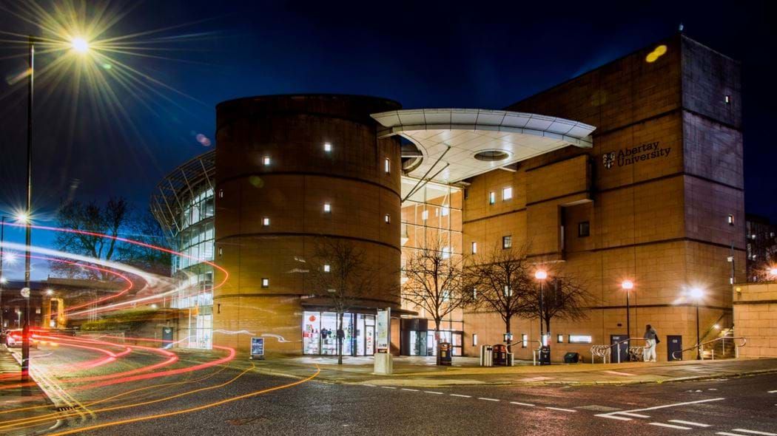

School of Design & Informatics
Professor Gregor White: Dean of School

Slide 17

Driving the Digital Economy
Abertay University is an anchor Institution for Scotland’s Tech industries
Growth of the digital sector closely linked to the cultural vitality of the city
Supplies talent pipeline into the city and beyond
Since 2016, the School of Design & Informatics has been central to over £35M of R&D investment in the digital sector.
Focus on tech-based innovation, research and development with regional, national and international partnerships
School of Design& Informatics

Slide 18

School of Design & Informatics
The UK Centre of Excellence for Computer Games Education
National Centre for Cyber Security (NCSC): Academic Centre of Excellence
InGAME: Innovation for Games and Media Enterprise
Abertay cyberQuarter
Emergent Technology Centre
5G Testbed/Scottish 5G Centre.
School of Design& Informatics

Slide 19
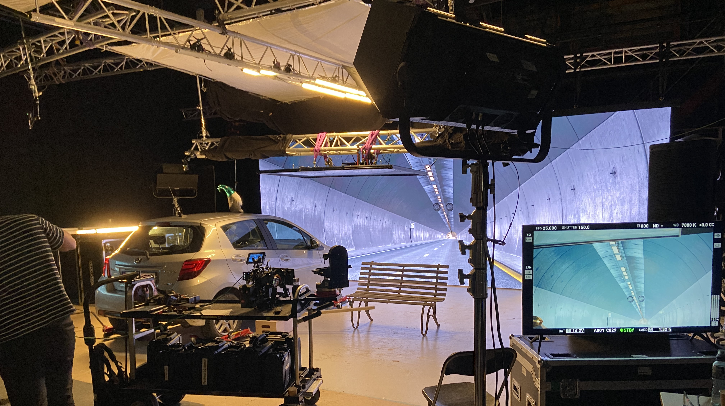
5G Testbeds & Innovation
5G for Virtual Production
Multi-locations simultaneous
production
Location data management and transfer
On-set integration
5G for Rural Drone Use
Search & Rescue
5G in a box
Portable network
Delivering emergency care/supplies
School of Design& Informatics

Slide 20

Engagement & Enterprise Pipeline
Postgraduate Research & Development projects
PhD, Knowledge Transfer Partnerships
Elevator, Tech Scaler
Interface Innovation Vouchers
UKRI-InnovateUK
School of Design& Informatics

Slide 21

Technical partner for Scotland 5G Centre, Dundee City Council and AberTay
Brad McGuire
Director of Programme Innovation

Slide 22

AWTG: A Leader in 5G, Software and Engineering
Private 5G/4G/WiFi/IoT Networks
Software Development
Engineering Services

Slide 23
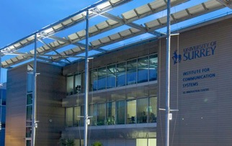


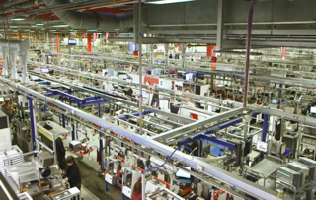
Private 5G Networks
Sunderland: BAI: Smart Cities
Freshwave: Deployment and testing
Bestway: Digital transformation of distribution business
University of Surrey 5G Innovation Centre: 5G R&D
Worcestershire 5G Testbed: Industry 4.0
University of Glasgow: Urban 5G
Scotland 5G Connect: Agritech & Rural Healthcare
Culham (UKEA) and Millbrook Proving Ground: CAV
Dundee City Council: e-Sports, Immersive & Tourism
DCMS Future RAN: Flex5G Project Lead
Qinetiq: Air to Ground
Digital Catapult: Studios UK, Virtual Production
S5GC: SME Adoption
S5GC Crichton: Health care
AWTG a leading 5G systems integrator.
We provide all the services you need to achieve your 5G vision: we consult, plan, design, deploy, maintain and operate indoor and outdoor private 5G Networks; we plan, execute and evaluate 5G use cases; we provide technical support to help SMEs adopt and exploit 5G.
AWTG built the first 5G test bed in 2015 and the first standalone 5G network 2021.
Our strategy is to be the UK’s number 1 Private 5G Network Provider and Pioneer in Open RAN.

Slide 24

































































AWTG is working with organisations across public and private sectors
“
The AWTG team has seamlessly integrated into the BAI team within Sunderland providing the design and delivery skills to implement and test a 5G Core, integration with core WiFi components and 5G radio sites, and network resilience analysis to drive the network into the future”
Regional and Local Government
Central Government
Technology Vendors
Mobile Network Operators
Vertical Applications
Health and care
Industry Bodies
Researchers
Network Engineering
Platform Development
Software applications
10+ 5G Testbeds in UK
Thousands of 5G and advanced wireless sites deployed in Public and Private Networks
Digital Asset Management Platform
Service Assurance Platform
Coverage assessment and mapping
Economic Regeneration
Intelligent Healthcare
Industry 4.0
Smart Place
Immersive Tourism

Slide 25
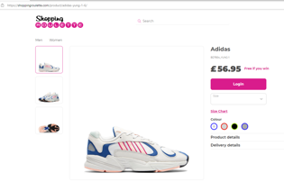
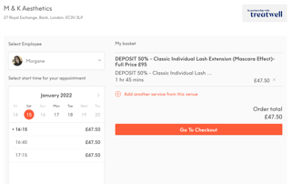
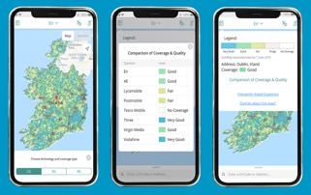
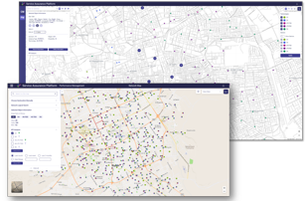
Software Development - Examples
High Street Recovery: iRegen for Placemaking, e-Trading & e-Bookings
Community Support: iYouth (Limerick Youth Services)
Education and Training: Be More Apprenticeship Portal (Liverpool City Region)
Digital Asset Management: Flex-5G for Asset Sharing & Monetisation (WLA)
Regulatory Services: Mobile Coverage Mapping (ComReg)
Retail: Gamified eCommerce and AI Driven Portals
Leisure: eBookings
Health: Clinic Management, Booking and Scheduling
Telecom: Site, Network, Configuration and Performance Management

Slide 26




Engineering Services
Consultancy
Network Strategy
Coverage Mapping
Plan, Design, Survey, Build, Test, Optimise, Manage
Any technology: 4G, 5G, Wi-Fi, IoT, FWA, Neutral Host
Spectrum Acquisition and Management for Private 5G
Regulatory: Comreg & TRA
NHS: Norfolk & Suffolk Foundation Trust, 50 Site Wi-Fi
Housing: FOLD Group, Wi-Fi in Supported Living
Education: City & Guilds, Wi-Fi in UK & ROI Sites
Central Govt: Commonwealth Secretariat, Wi-Fi
Local Authority Wi-Fi: Barnsley, Kingston, Westminster
LA Coverage Mapping: Basingstoke, Cambs, Norfolk
Emergency Services Network: Consultancy Services

Slide 27
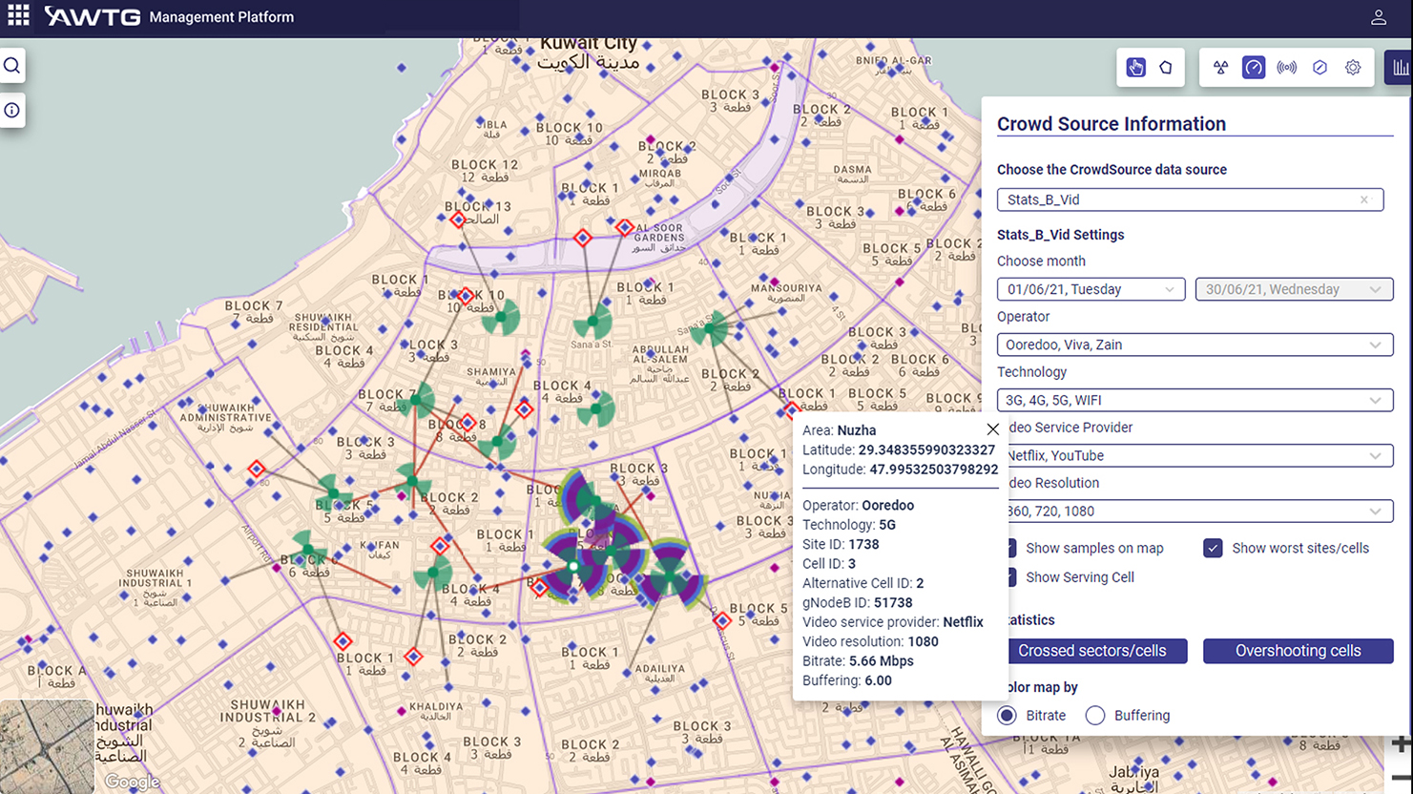
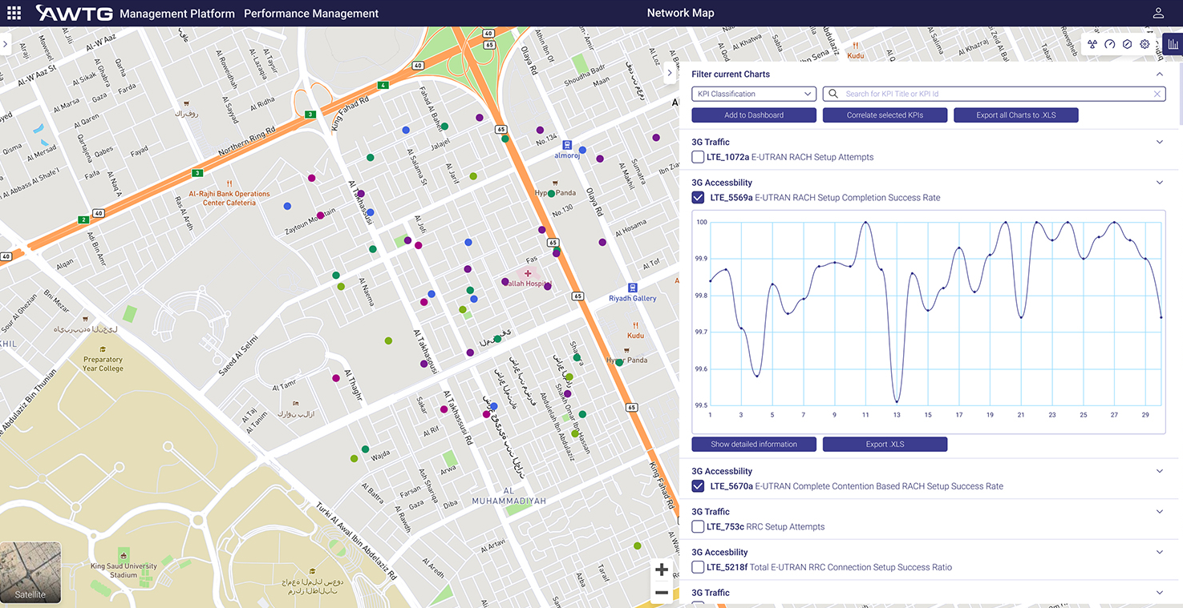

AWTG has invested in three key platforms to support growth in Mobile Private Networks
Enterprise OSS/MPN-in-a-box
iDAMS
Digital Asset and Site Management
They will need lightweight, cloud-based tools to plan, deploy, secure and manage their network assets, as well as skilled, experienced systems integration and network engineering talent.
SCAP
Service Correlation and Assurance Platform
Flex-5G
Flexible, Efficient and High Performance 5G Open RAN
AWTG is actively seeking go-to-market partners for this proposition

Slide 28
Partnership in Dundee

Slide 29
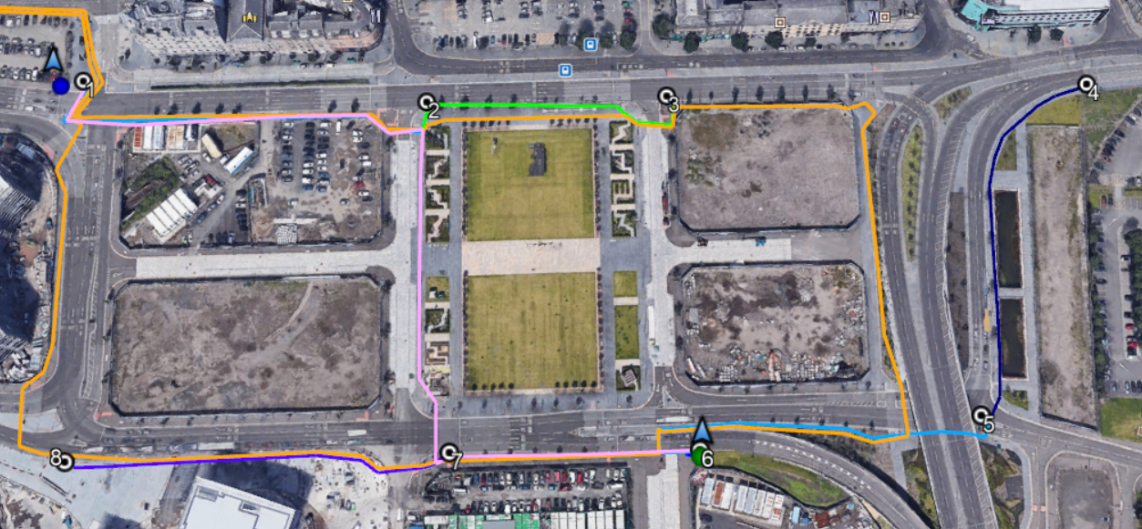
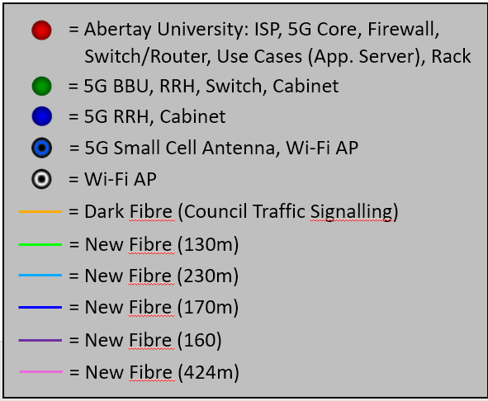
Waterfront Overview

Slide 30
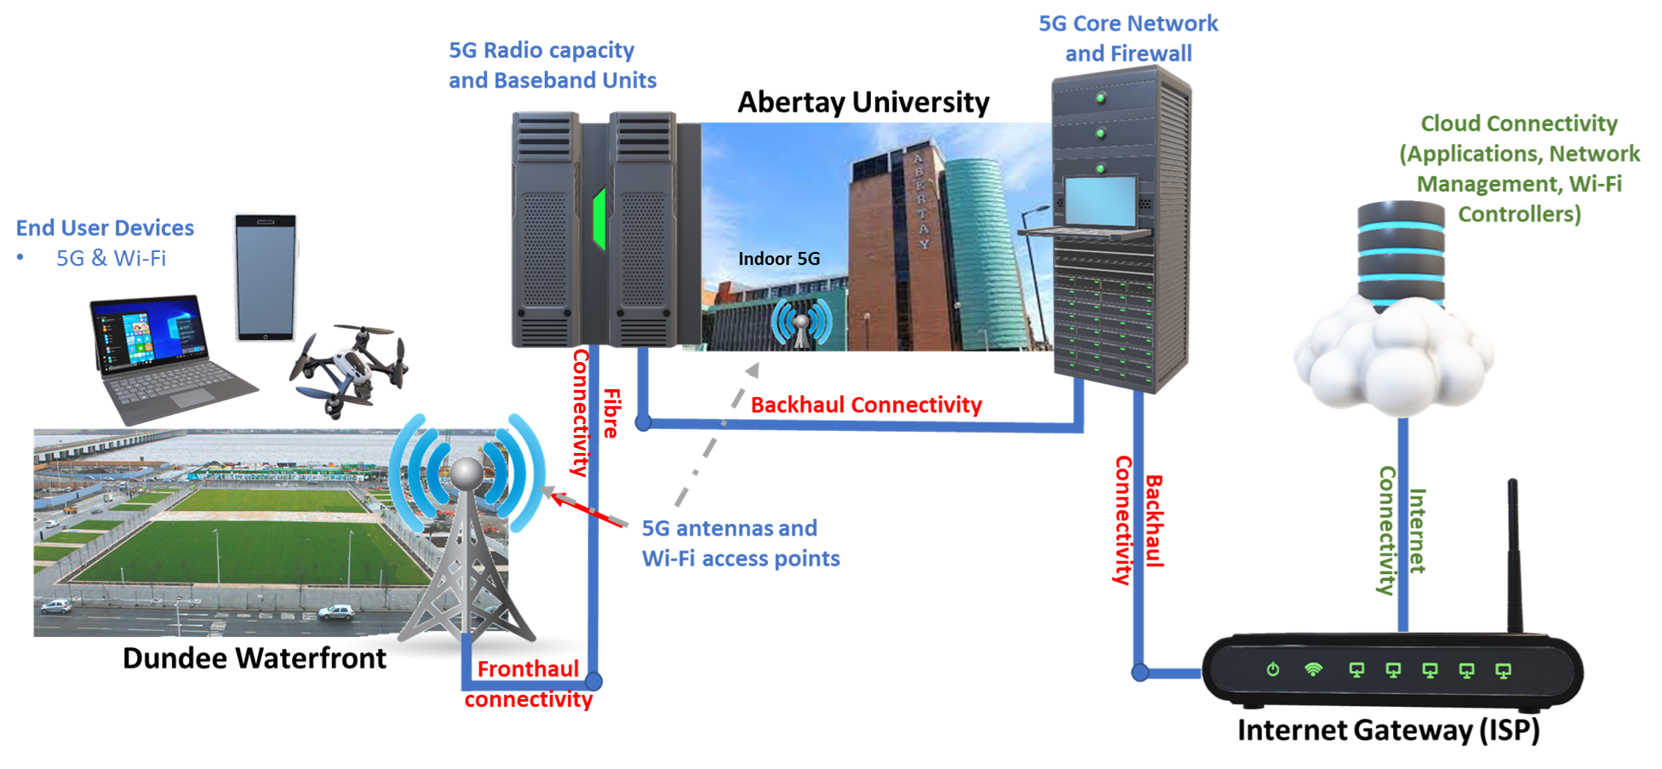
Dundee 5G Topology

Slide 31
What next…..
  Collaboration in the city – a broad eco-system
    S5GC
    Council
    University
    Industry
  Providing a variety of innovation services to allow the industries, businesses and residents to talk about 5G and advanced connectivity in terms of:
    Benefits
    ROI
    Digital transformation

Slide 32
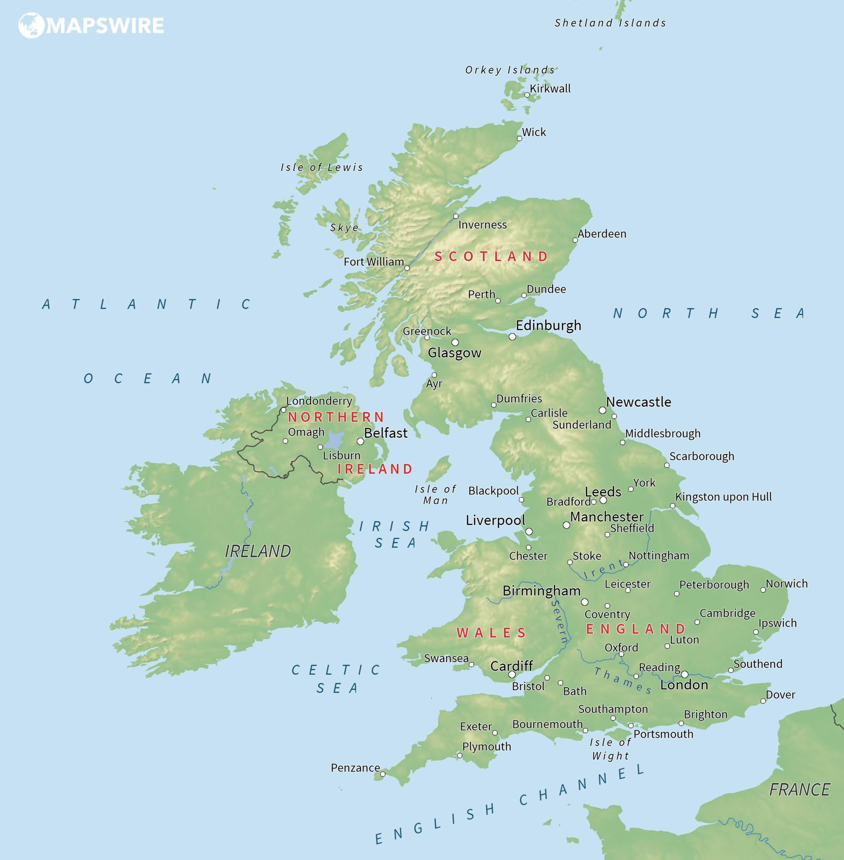
…and there are over 500 potential Smart Communities in the UK alone
Scotland:
SGIC
Dundee 5G + Wifi, Gaming, Abertay/Waterfront
Dumfries and Galloway 5G Hub, Rural Health and Care
University of Glasgow 5G R&D
University of Strathclyde 5G R&D (EV)
National Health & Care:
NHS England/Digital/X
Future Wireless Strategy/DCMS
New Hospital Building Programme (5G in a Box)
NE/Sunderland:
Sunderland NH
Newcastle/NTCA
Manchester
Transport for GM – Vivacity partnership
Smart Junctions network – scale-up
Liverpool:
City Region BeMore Apprenticeship App
5G Create Healthcare testbed evolution
Yorkshire/Lincs
Sheffield City Region
Future High Street Fund
City Region Digital Strategy
Fibre in Water 5G network (Yorkshire Water)
Milton Keynes:
MK:Create 5G Testbed – future evolution into production and ongoing operations
Autonomous vehicles/Robotics/Drones
West Midlands
Health & Care
Transport
WM5G evolution
West Mercia (Hereford & Worcester)
Health & Care
NHS H&W ICS
Norfolk & Suffolk NHS
WiFi across 100 sites
Design, Build & Operate
Future growth/4G-5G MPN
Millbrook Autoair
Future network and CCAV expansion
London
DCIA project WLA
GLA CDO
Dorset:
Rural connectivity
Economic growth
Health & Care
Network Rail
Purple
Cisco
This Photo by Unknown Author is licensed under CC BY

Slide 33
For further information, please contact
Brad McGuire
brad.mcguire@awtg.co.uk
+44 (0) 7785 576 453

