Slide 1
Welcome
S5GConnect HALO Kilmarnock Launch
2.15PM
Registration/ Free Tea/Coffee/Refreshments available.
2.45PM
Talks
Dr Marie Macklin CBE Video
(Founder and Executive Chair, HALO Urban Regeneration)
Sharon Neely (Business Engagement Manager, S5GC)
Kim Moran-Hogg (Head of Sales, Vodafone Business)
3.30PM
Demonstrations
Q&A & Networking
5.30PM Finish

Slide 2
Speakers
Sharon Neely
S5GConnect HALO Kilmarnock
Business Engagement Manager
Dr Marie Macklin CBE
HALO Urban Regeneration Company
Founder and Executive Chair
Pre-recorded
Kim Moran-Hogg
Vodafone Business
Head of Sales (Scotland and NI)

Slide 3
The Scotland 5G Centre
The National Centre for accelerating the adoption of 5G connectivity in Scotland’s Industry and Public Sectors
“Delivering economic benefit through accelerating the deployment and adoption of 5G enabled solutions in Scotland”
1
2
3
4
Coverage
5G Support
Engagement
Innovation
Enabling the development of new mobile solutions to improve coverage.
Supporting organisations procure and deploy 5G networks.
Demonstrating the value of 5G to businesses.
Supporting innovation and access to investment.
Notes:
Start with:
Thanks Marie etc.
As Marie mentioned it is a great opportunity for the Centre to be here in Kilmarnock, - let me explain a bit more about the centre, who we are, what we do.
Comment on the slide content
We, are the national centre …
we are delivering economic benefit …
And these are the 4 key strategy pillars the centre is working and focused on right now (comment on the 4 of them)
Some ideas of what else can be said on 3 and 4
Engagement is an important one, especially here at the hub, as we help organizations and SMEs understand the value of 5G and what 5G can offer to their business, products and services.
Innovation, is critical in a technical arena like 5G and that’s why at the centre we support and invest in your projects across Scotland, which you’ll hear about later.

Slide 4
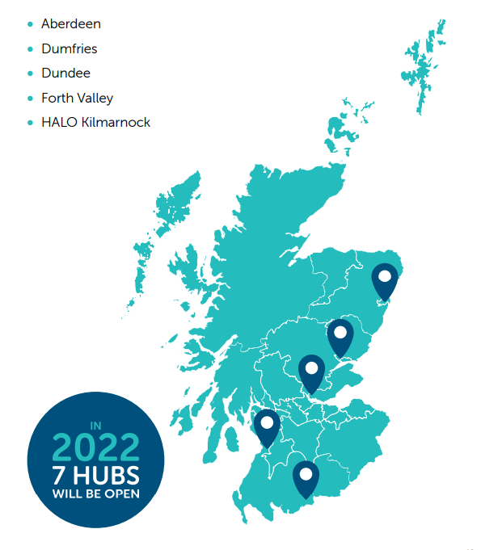
Scotland 5G Connect Programme: National Presence, Regional Focus
A National facility:
Organisations can access our suite of S5G Innovation hubs and test beds across Scotland (5 are opened, 2 are opening soon).
Each hub provides free access to cutting edge 5G mobile private networks, allowing organisations to test: new 5G enabled products, services, efficiency savings and innovative solutions.
Our Hub based Business Engagement Managers are working with organisations across Scotland to explore and develop 5G solutions that have the potential to transform Scotland’s business.
Notes:
Start with: In order to accelerate the adoption of 5G in Scotland, we have created the S5GConnect Programme. The S5GConnect HALO Kilmarnock hub is 1 of the 5 hubs which are currently opened and located within Scotland. The other 4 hubs are located in Dumfries, Aberdeen, Forth Valley and Dundee and two more will be announced very soon.
The hubs offer the opportunity for organisations to have free access to … (content on the slide, 2nd bullet)
And we are working with organisations as aforementioned to explore and develop (comment on the slide, 3rd bullet)

Slide 5
S5GConnect HALO Kilmarnock
At S5GConnect HALO Kilmarnock we offer a range of support services, facilities and opportunities for businesses of all sizes to test and develop new 5G applications.
AWARENESS/BUSINESS SERVICES
• Partner Matchmaking & Introductions
• 5G Education & Knowledge Sharing
• 5G Funding Advice
• Private 5G Network Advice
• Project and Use Case Scoping
5G INNOVATION SERVICES
• Access to our 5G mobile private network
• Access to devices and equipment to enable 5G connectivity & testing
• 5G Development Workshops & Digital Infrastructure Insight
• 5G Integration & Procurement Advice
• Expert advice through your 5G journey
Notes:
Start with:
To give you a wider overview on the services that we offer here at the hub, apart from the access to our 5G mobile private network, we offer…
Focus on some of the services 2/3 per section,
To close this slide, you can say something along the lines: This is therefore a fantastic opportunity for organizations, SMEs, business, to come and test their products and services within a 5G environment, all risk free.

Slide 6
Our Core 5G Projects and Partners
The Scotland 5G Centre has invested in three core projects (through our partners University of Glasgow, University of Strathclyde and the Scottish Futures trust) to develop innovative 5G solutions, boost connectivity, develop skills, and develop cutting edge technology.
Urban Project
Rural Project
Infrastructure Project
University of Glasgow:
Creation of a 5G research test bed
University of Strathclyde:
Demonstrating new rural coverage options
Scottish Futures Trust:
Toolkit to reduce barriers to infrastructure roll out
Bringing new 5G technological solutions to urban communities and businesses throughout Scotland
Improving connectivity options for remote communities and businesses, creating a new 5G ecosystem in Scotland
Breaking down the complex processes and legislative barriers that have delayed the rollout of 4G and 5G infrastructure
S5GC has invested over £1.6 million of funding with an ROI of £29 million
S5GC has invested over £1.9 million of funding with an ROI of £2.5 million
S5GC has invested over £390k of funding
Sensored Monitoring Seating
Remote Operated Robotic arm
3D Holographic solution for Healthcare
Rural Connectivity solution
Low cost event broadcasting
Private 5G Network toolkit
Neutral Hosting solutions
Standardisation
Payment Guidance
Connectivity Marketplace
Infralink-Exchange
Notes:
As highlighted before, innovation is a key pillar for the Centre, and that’s why the centre is funding three core projects aiming to develop innovation 5G solutions.
One is an Infrastructure project led by our partners at Scottish Future Trust, Infralink project, where they are trying to simplify the complexity behind the roll out of 4G and 5G infrastructure.
Another project, is the rural project, led by the StrathSDR team, with Pr. Bob Stewart in the audience today (only if he attends mention he is in the audience), where they are developing cost effective connectivity solutions for remote and/or rural areas and outside broadcasting, you probably have heard that recently they were involved in the Queen’s departure from Scotland, where the designed and deployed the pioneering ‘private 5G’ network technology to connect cameras, and broadcast worldwide that unique event, a world-first, we are proud to support.
And last but not least, an urban project led by University of Glasgow and the CSI team, they have created a 5G test bed, and are developing different 5G uses cases to help urban communities and business and also to overcome some of the recent challenges Scotland is facing from a connectivity perspective. One of the demos you’ll see later will be provided by University of Glasgow, so we hope you like it. Feel free to ask them any questions you have on 5G-enabled tech and the project itself.
Now handing over to the last speaker Kim … (if the running order stays like that) so then Kim can officially declare for the hub to the opened.

Slide 7
Events
Look out for S5GC events happening near you by visiting scotland5gcentre.org/events
Contact Us for Questions
Sharon Neely
Sharon.Neely@scotland5gcentre.org
Thank you
Our Partners:
Create
new tools and services to combat cyber-crime activities.
Monthly Newsletter
The Crichton Trust
South of Scotland Enterprise
Borderlands Inclusive Growth Deal
Get the latest events and developments at the Scotland 5G Centre by signing up to our online newsletter.
www. scotland5gcentre.org

Slide 8
Vodafone & The Scotland 5G Centre in Partnership with Halo Kilmarnock
Kim Moran Hogg

Slide 9
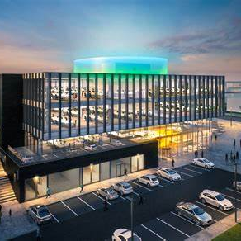
Partnership Working hand in hand with S5GC
and businesses to make Scotland
a leader in 5G.
Accelerate adoption of 5G
Build new skillsets
Technology usage and adoption trends
Scotland a Digital Leader
Economic benefits and insight
Learnings from trials
Exposure to new technology, ways of working and business models
Create, test & deploy new applications
Insights from peer groups
New revenue streams
MPN Innovation and Use Cases
Testing
Learning and insights
Continuous Development
Access to new businesses and industries
Underpin Scotland’s ambition
HALO Kilmarnock Innovation Hub
Businesses

Slide 11
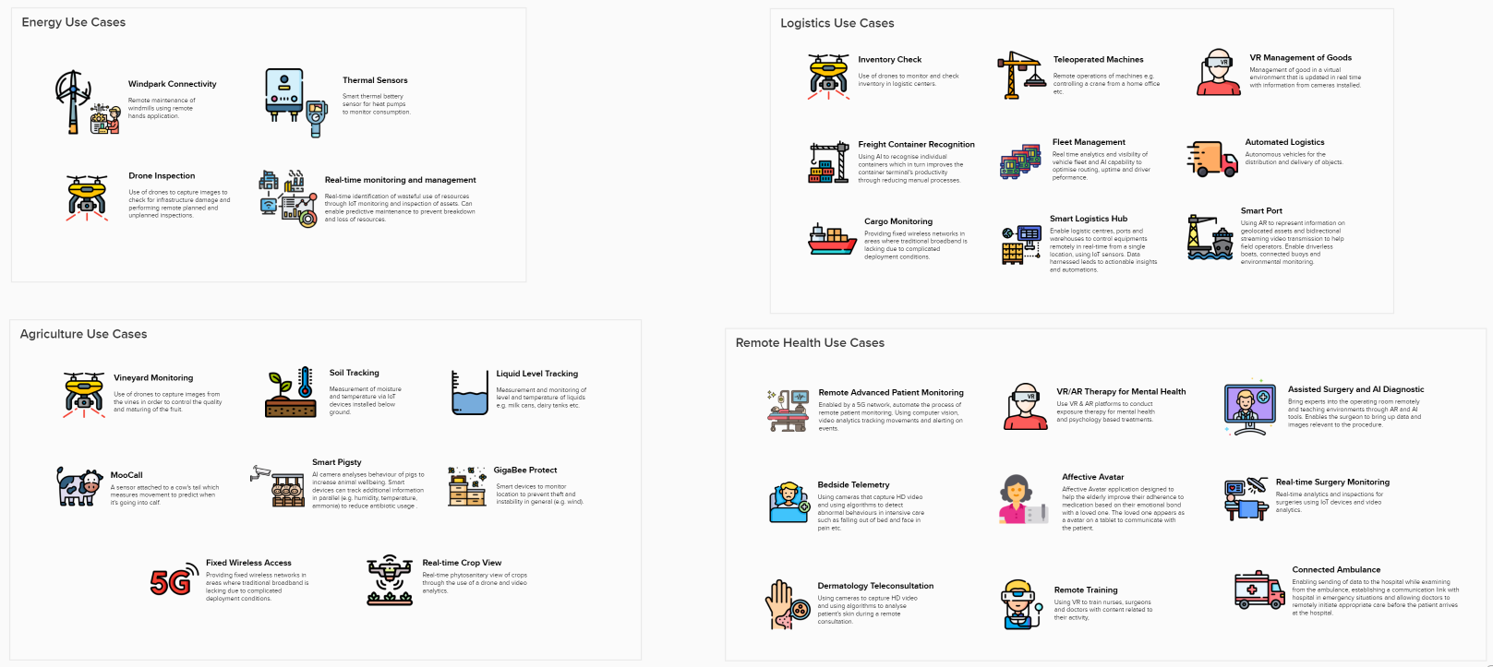
xxx
MPN
Use Cases
Notes:
Cocreation methodology
Jordan burnside 5G observatory
250 pocs our credentials
Scotland projects

Slide 12
5G Demonstrations
Environmental Monitoring
Dr Shuja Ansari
Mixed Reality
Callum Booth
Tactical Surveillance Solutions
Mark Benson

